Slide 1
Meat Messaging Industry Portal Training Session
https://www.meatmessaging.info/

Slide 2
Contents
Introduction to MeatMessaging
MeatMessaging workflow
GS1 barcoded carton labels
Implementation steps
Web service model
Creating a massage – manual method
QA Monitoring
Receiving a consignment

Slide 3
Introduction to MeatMessaging
The cost to industry for missing or incorrect port marks to the US is estimated at $14.5 million per year in the June 2013 report by D.N Harris & Associates on the technical barriers to trade for Australian red meat prepared for MLA and AMIC.
The costs to industry for manual preparation of Meat Transfer Certificates is estimated at a cost of $25 for the labor component per MTC. There are approximately 175,000 paper MTCs per year. This equates to a cost of $4.375 million per year.

Slide 4
Introduction to MeatMessaging
The use of the Meat Messaging portal based on the underlying GS1 barcoding and electronic messaging technologies and supply chain standards can readily reduce these two costs (total of $18.875 million) to virtually $0.
The industry web portal (meatmessaging.com) facilitates the collection, processing and reporting of carton GS1 barcode and related data to achieve the requirements of the issued DA Meat Notice “Alternate protocol for managing illegible or missing shipping marks for the USA” and the FSIS Notice 41-15 “Shipping marks-Barcodes.PDF”.

Slide 5
Introduction to MeatMessaging
The MeatMessaging portal includes a QA monitoring process that provides a level of reporting on the measured accuracy of the program participants. This process of QA monitoring is utilised as a validation tool for the endorsement of the updated approved arrangements for the establishments and reporting to government.
Over 50 establishments have signed up to use the meat messaging portal including the three largest processing companies in Australia. Collectively this represents over 70% of the Australian export volume.

Slide 6
Introduction to MeatMessaging
The MeatMessaging portal is a program reporting to the Australian Meat Industry Language and Standards Committee and is administered by AUS-MEAT Limited.
Establishments wanting to use the Meat Messaging portal need to work through with the system vendors to implement integration with their existing on plant systems. QA also need to ensure the establishment’s approved arrangements are updated to reflect using the Meat Messaging portal.

Slide 7
MeatMessaging Workflow
An establishment creates 3 kinds of DESADV messages:
eMTC – message used to move export eligible product from one establishment to another establishment.
Export – message used to move export eligible product from an establishment to an export location with a health certificate
Domestic – message used to domestic export eligible product from an establishment.

Slide 8
MeatMessaging Workflow
An establishment can create a DESADV message in 3 possible ways:
Logging into the meat messaging web site and manually:
Completing all the message details and uploading a scan file for each group of carton.
Completing all the message details and uploading a group scan file (.CSV or .txt) that contains the groups and the cartons.
Manually uploading a DESADV message (.DSV file).
Email of a DESADV file to a meat message email address. The message is picked up and processed in meat messaging.
Web service where a data file (XML) is uploaded with required data. The web service can be used multiple times to update and read the status of a specific message.

Slide 9
MeatMessaging Workflow
The establishment can update the message until the message is sent.
Once a message is sent (the Message status element is set to “SENT”) the recipients are sent an email notification stating that they have received a message. Once sent no element of the message can be altered, accept the “Port/Place of discharge”. The receiver of the product has 3 possible ways to respond:
Logging into the meat message web site and manually completing the receipt details along with manually uploading a scan file.
Emailing a receipt message (.RCV file) to meat messaging email address. The message is picked up and process in meat messaging.
Web services where a data file is uploaded with the required data.

Slide 10
MeatMessaging Workflow
Once a message is receipted in meat messaging the status is changed to “RECEIPT”. If the originator of the message created the message with a emailed DESADV file a receipt file (.RCV file) is emailed to the originator of the message. If the originator created the message manually or through web services an email is sent to the originator with the results of the receipt process.

Slide 11
MeatMessaging Workflow
Receiving email file overview:
Establishments that receive shipment using the Meat Messaging portal have the option of sending a simple CSV file to a set email address with a set subject line to fulfil the process of receiving a consignment. This option is most useful for establishments that have limited information about the consignment or limited information systems or software that prohibits communicating directly with the meat messaging portal.
Once the Meat Messaging Portal receives the email the data is processed and the establishment is sent an email with the summary of the consignment. The summary has the consignment verification details and any actions required.

Slide 12
MeatMessaging Workflow
If the data file has an incorrectly format subject line or the CSV is incorrectly formatted the email sender is sent an error email with a summary of the error.
Sending the CSV file:
The CSV file would be emailed by the establishment to the email address: receiving@meatmessaging.com
The subject line would be: Consignment received by user: 80000045
Where 80000045 is the user’s meat messaging ID number.

Slide 13
MeatMessaging Workflow
CSV file structure:
Barcode – This is the GS1 barcode for the carton label
Portmark – If applicable, this the port mark shown on the carton for the corresponding barcode.
MessageID – If know, this is the 18-digit message ID for the consignment.
Status – This is the status of the carton where:
0 = Good
1 = Missing Port Mark, if applicable
2 = Illegible Port Mark, if applicable
3 = Incorrect Port Mark, if applicable
9 = Damaged carton

Slide 14
MeatMessaging Workflow
Column headers are optional required.
The Port Mark is only included where it is applicable for the consignment. This would be export shipments to those countries that require port marks.
The Message ID is only included where the message ID is known at the time of scanning of the consignment.
At least a port mark or Message ID is required in the file for each barcode, except where one or more port marks are missing for a set of carton with port marks.

Slide 15
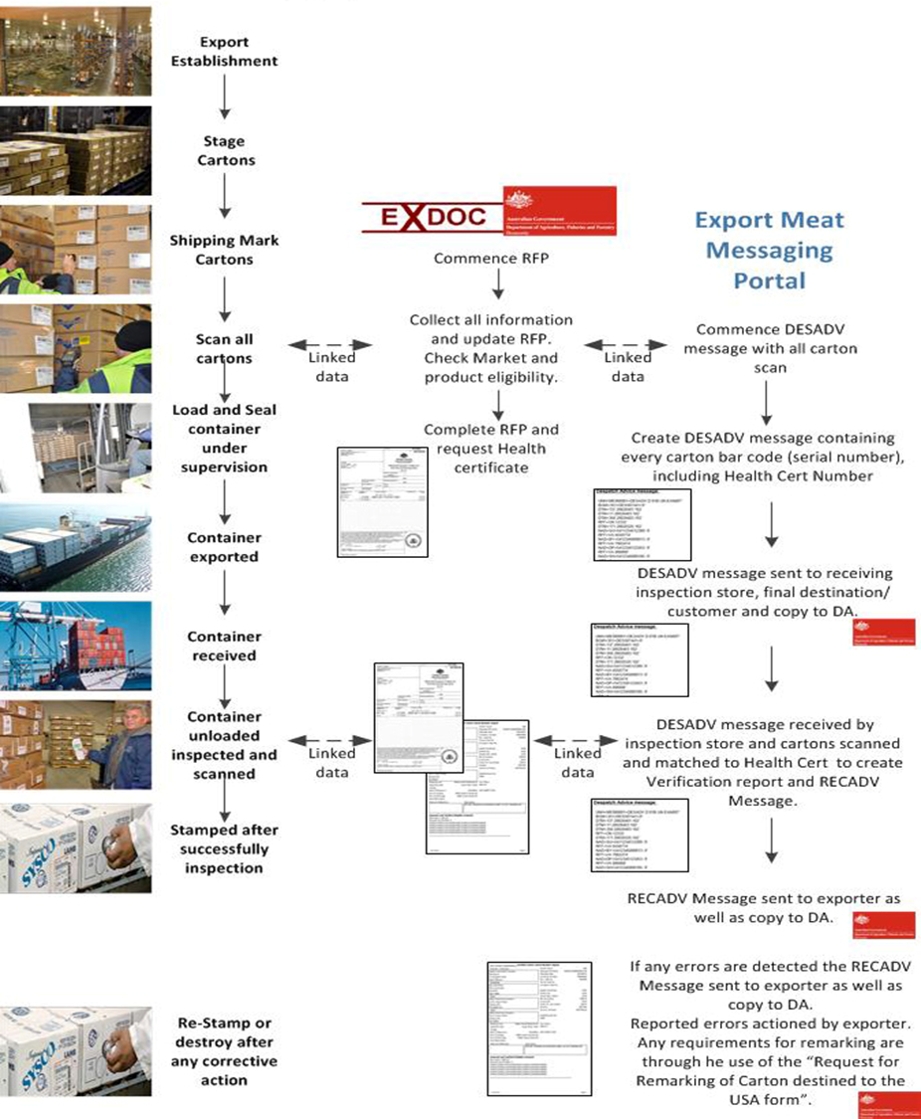
MeatMessaging Workflow

Slide 16
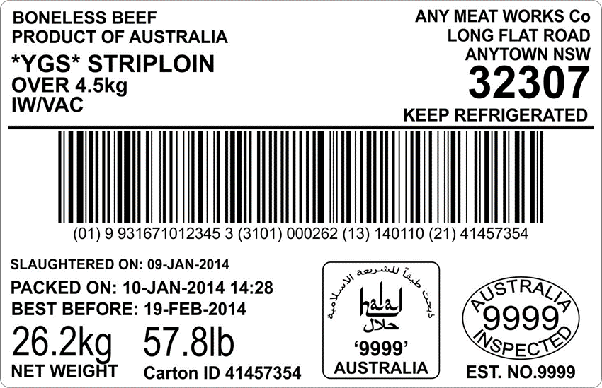
GS1 Barcoded Carton Labels
Trade description is defined in regulation – ensures consistency
Product codes are used to keep track of market/customer eligibility
Product codes/packing dates/serial numbers help identify and trace individual cartons and lots of cartons in inventory and in commerce
Carton unique serial number
Product code – related to market eligibility

Slide 17
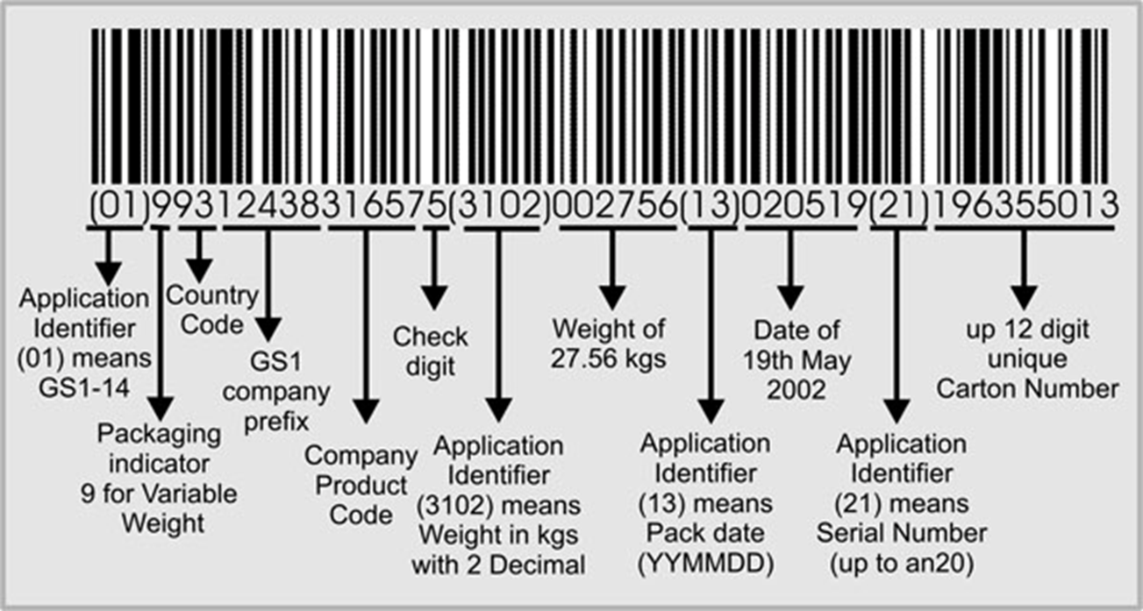
GS1 Barcoded Carton Labels

Slide 18
Implementation Steps
Step 1 – Register with MeatMessaging.com
Export establishments (processors and cold stores), Non-packer exporters, Importers, Receiving cold stores
Step 2 – Receive registration email with login details for each user
Each user has their own login and receives by email their login details
Step 3 – Login to test system (MeatMessaging.info) and create/ send test messages
Create messages for each consignment.
Upload carton barcodes for each product group in a consignment. (This is done through a simple file upload of a CSV of the carton barcodes).
Send the message to the receiving establishment (importer).

Slide 19
Implementation Steps
Step 4 – Receiving Establishment processes received test messages
Receive messages for each consignment.
Scan and upload some or all carton barcodes for each product group in a consignment.
Send receipt message to the sending establishment (exporter).
Step 5 – Work with your production system software provider for an integrated solution
If required, you can work with your software provider to integrate your production system with meat messaging to increase efficiency.

Slide 20
Implementation Steps
Step 6 – Update your Approved Arrangements to include using MeatMessaging.com
You will need to update your internal systems such as work instructions/ SOPs to include using MeatMessaging.com.
Once all the necessary system changes have been completed and verified have your Approved Arrangement amendments approved.
This approval process includes a 3rd party validation of your system.
Step 7 – Start using MeatMessaging.com instead of MeatMessaging.info
Once your Approved Arrangement amendments have been approved you can start using the production MeatMeassaging.com instead of the test system Meat Messaging.info

Slide 21
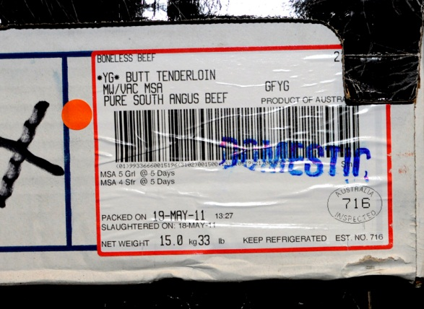
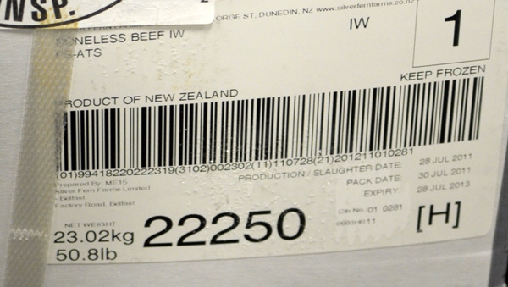
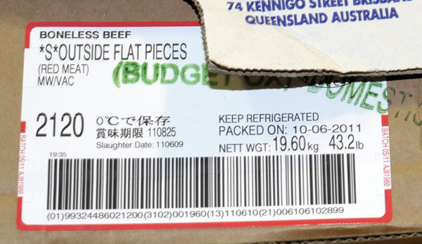
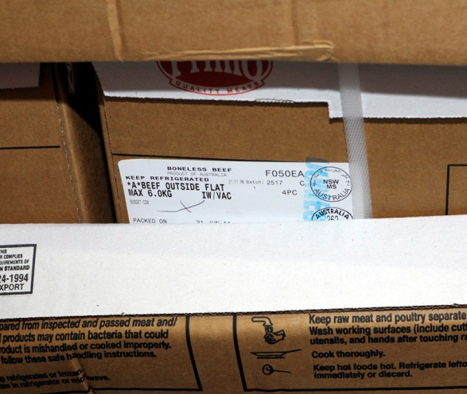
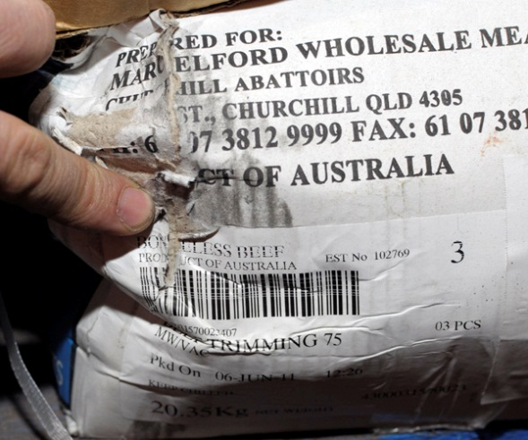
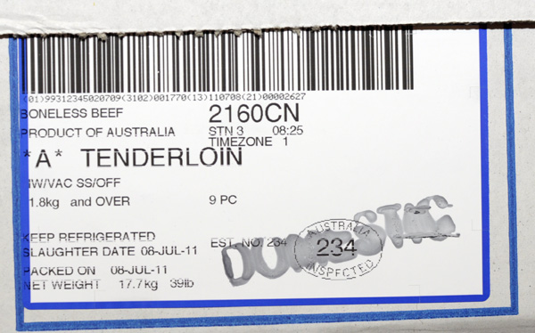
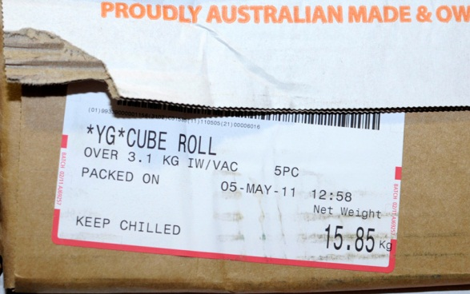
Implementation Steps
Training – Barcode quality

Slide 22
Web Service Model
New Message
Call from Company System to MeatMessaging.com for new message with:
User Code, Company ID, Password and function code.
Any Available Data elements.
Response (successful) from MeatMessaging.com with:
Message_SSCC
All updated/ stored data elements

Slide 23
Web Service Model
Update Message
Call from Company System to MeatMessaging.com to update message with:
User Code, Company ID, Password and function code.
Message_SSCC
Data elements to add or update.
Response (successful) from MeatMessaging.com with:
Message_SSCC
All updated/ stored data elements

Slide 24
Web Service Model
Read Message
Call from Company System to MeatMessaging.com to read message with:
User Code, Company ID, Password and function code.
Message_SSCC.
Response (successful) from MeatMessaging.com with:
Message_SSCC
All data elements.

Slide 25
Creating a message – Manual method
The manual method to create and send a message is shown on the next few slides.

Slide 26
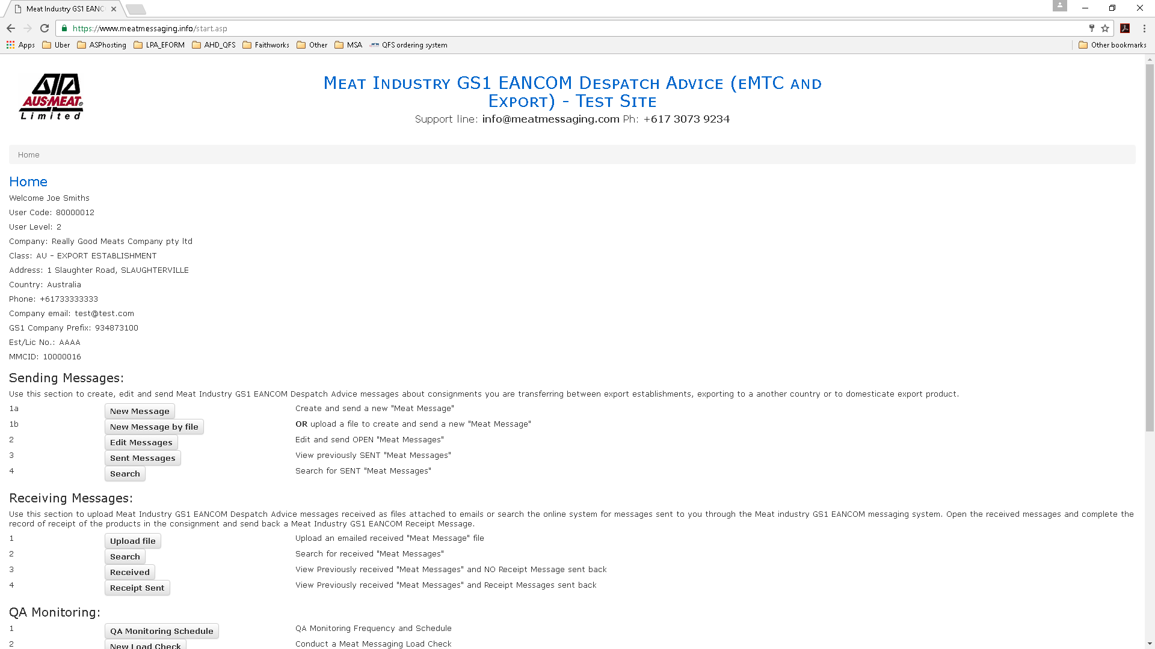

Slide 27
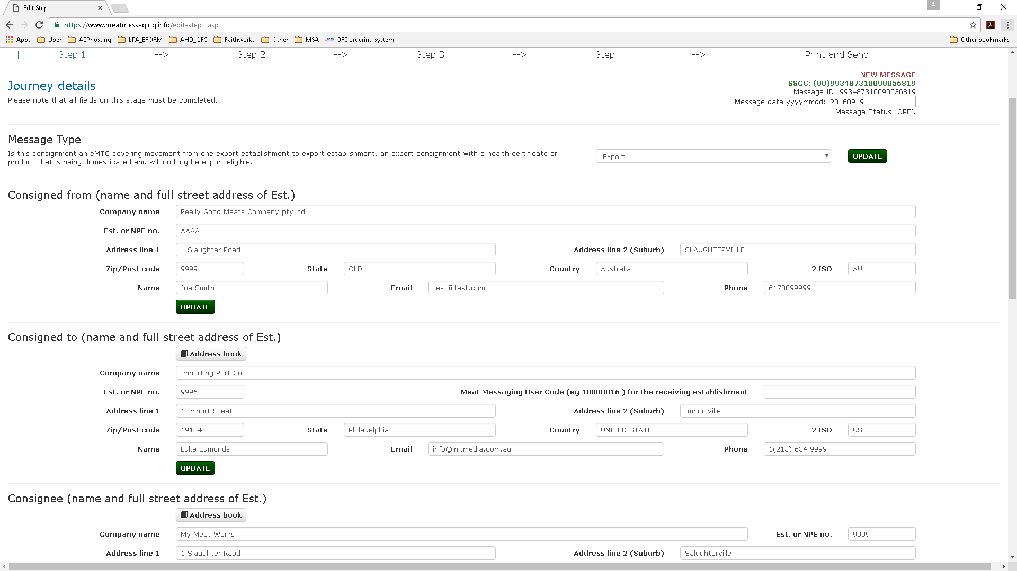
Select message type
Update to save changes
Select consigned to
Select consignee

Slide 28
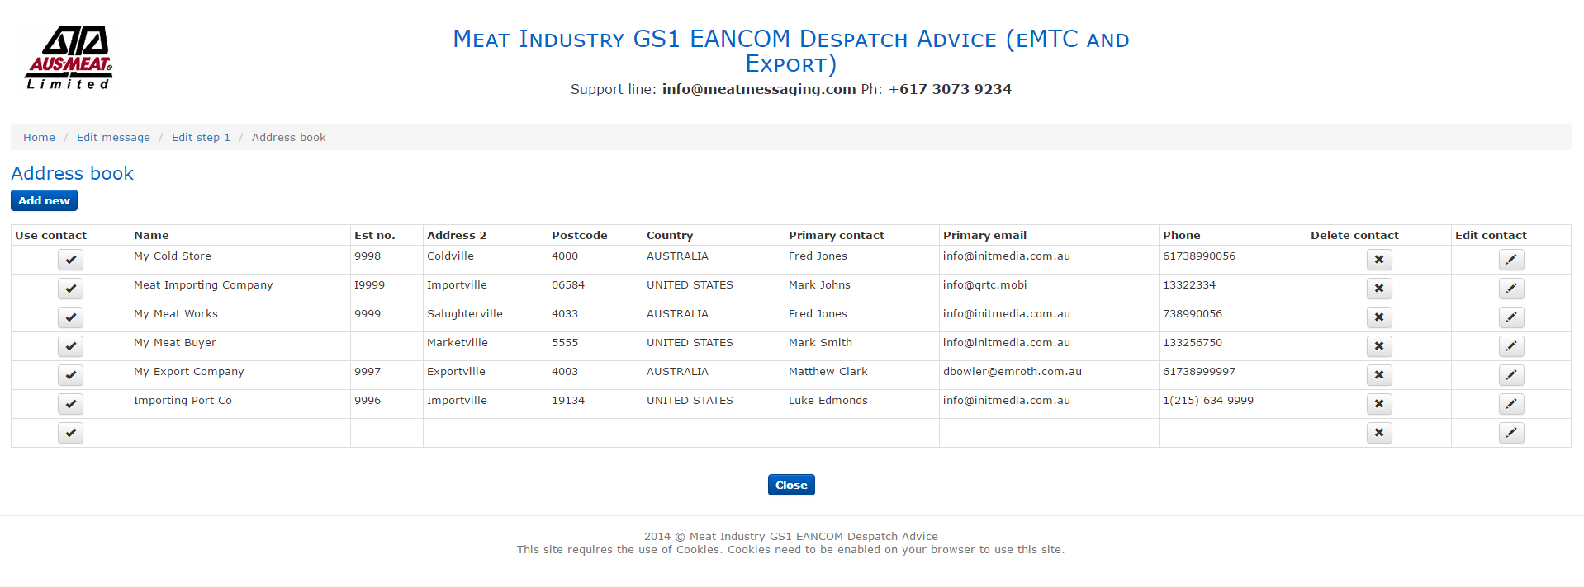
Select in address book

Slide 29
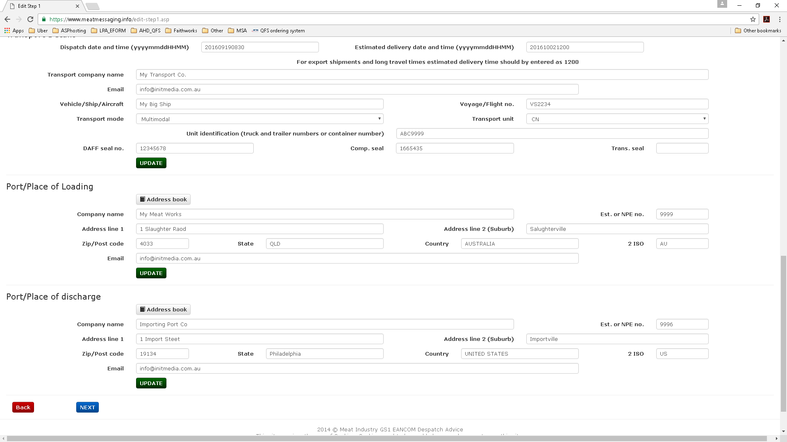
Enter transport details then update
Select port/place
of loading
Select port/place
of discharge

Slide 30
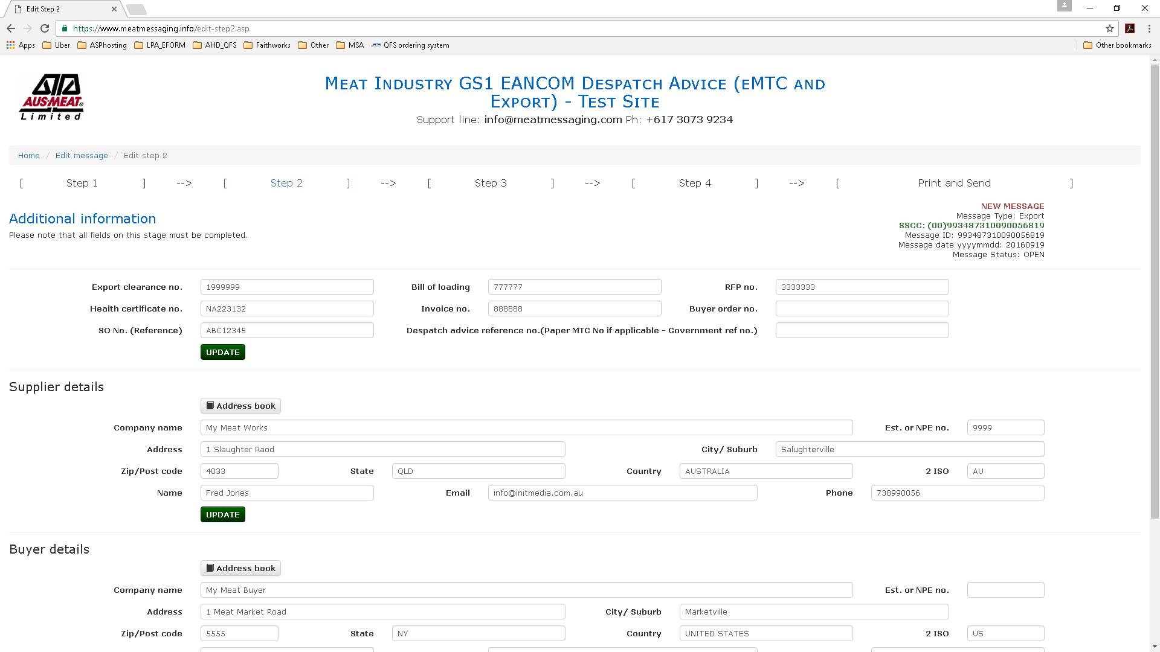
Enter details then update
Select supplier
Select buyer

Slide 31
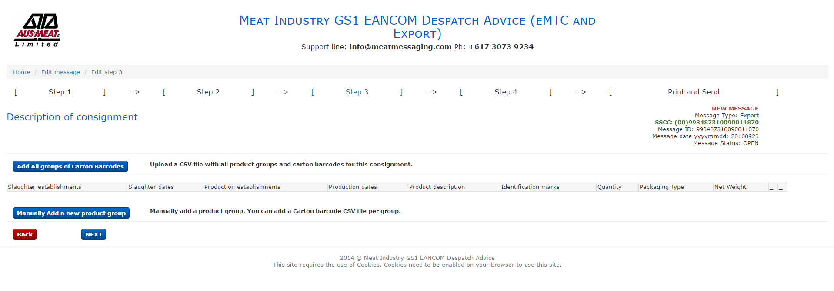
Add new product group

Slide 32
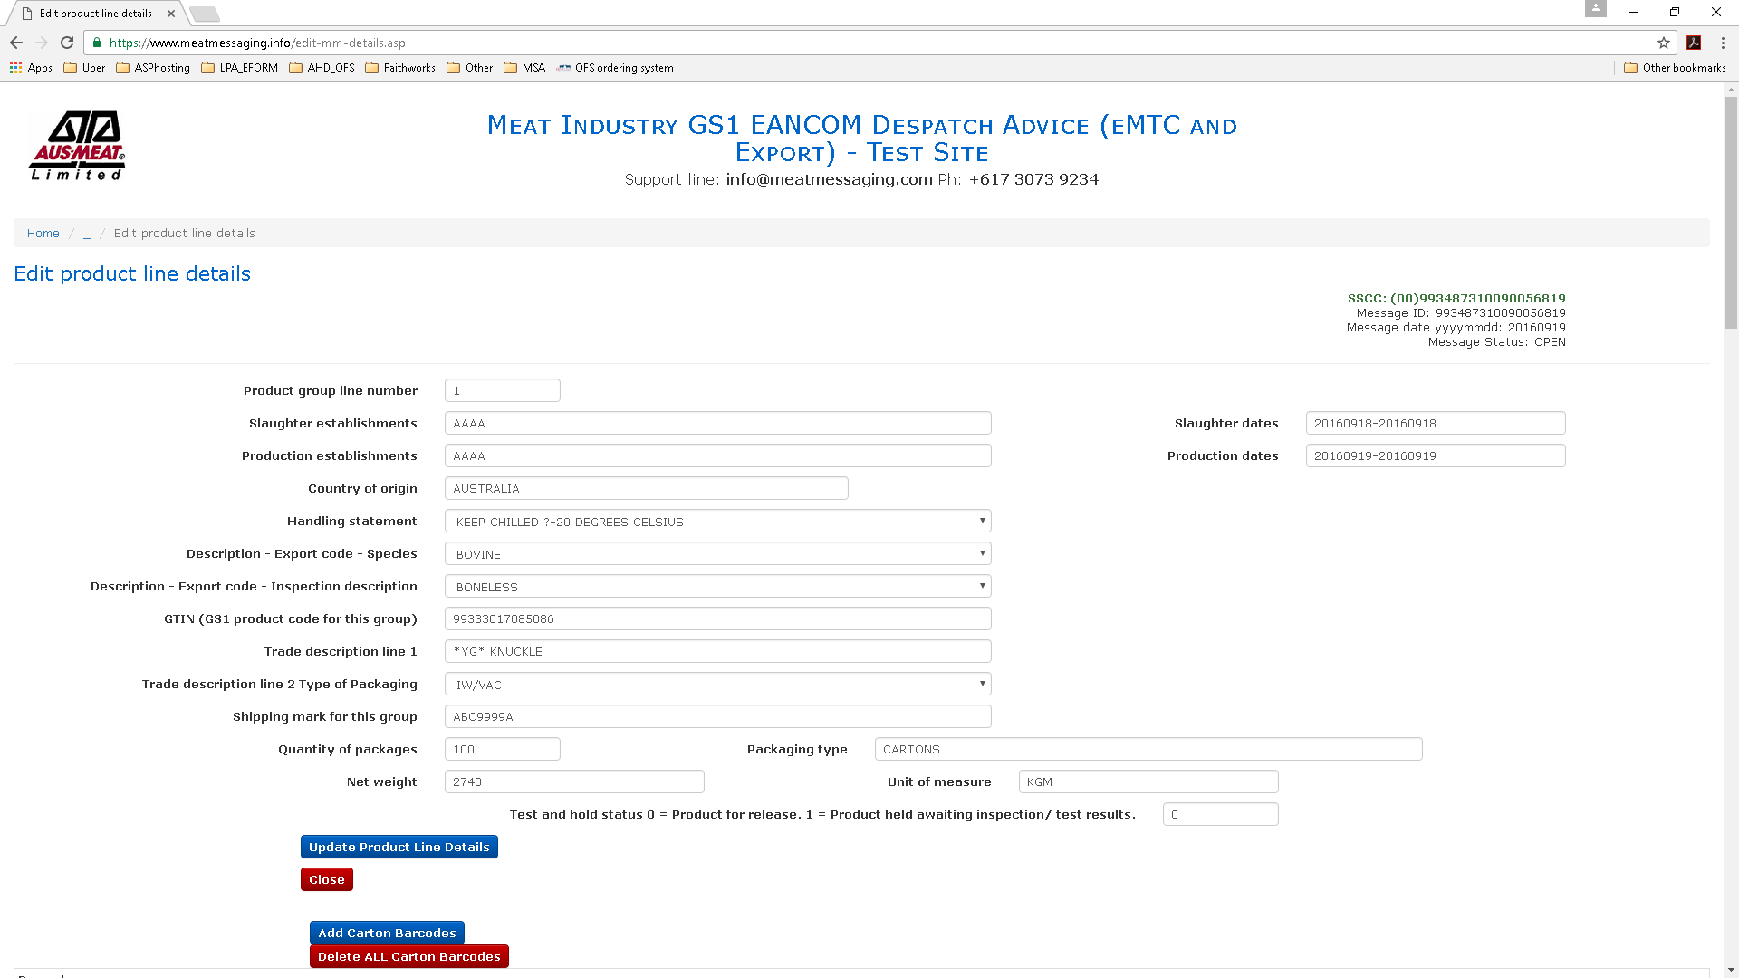
Fill out product details
Add carton barcodes

Slide 33
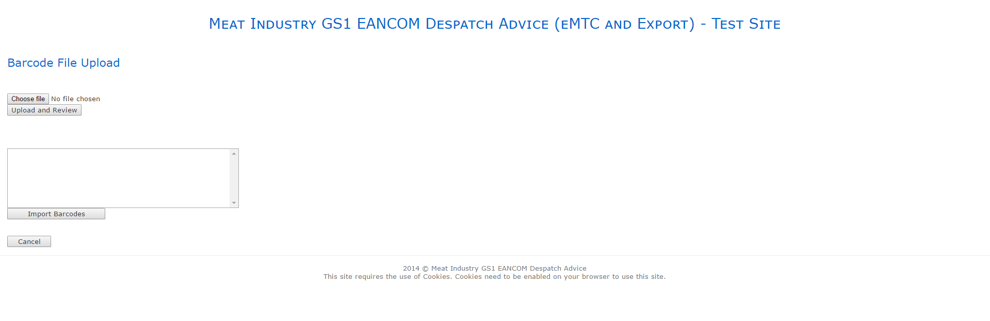
Choose file
Upload and review
Import

Slide 34
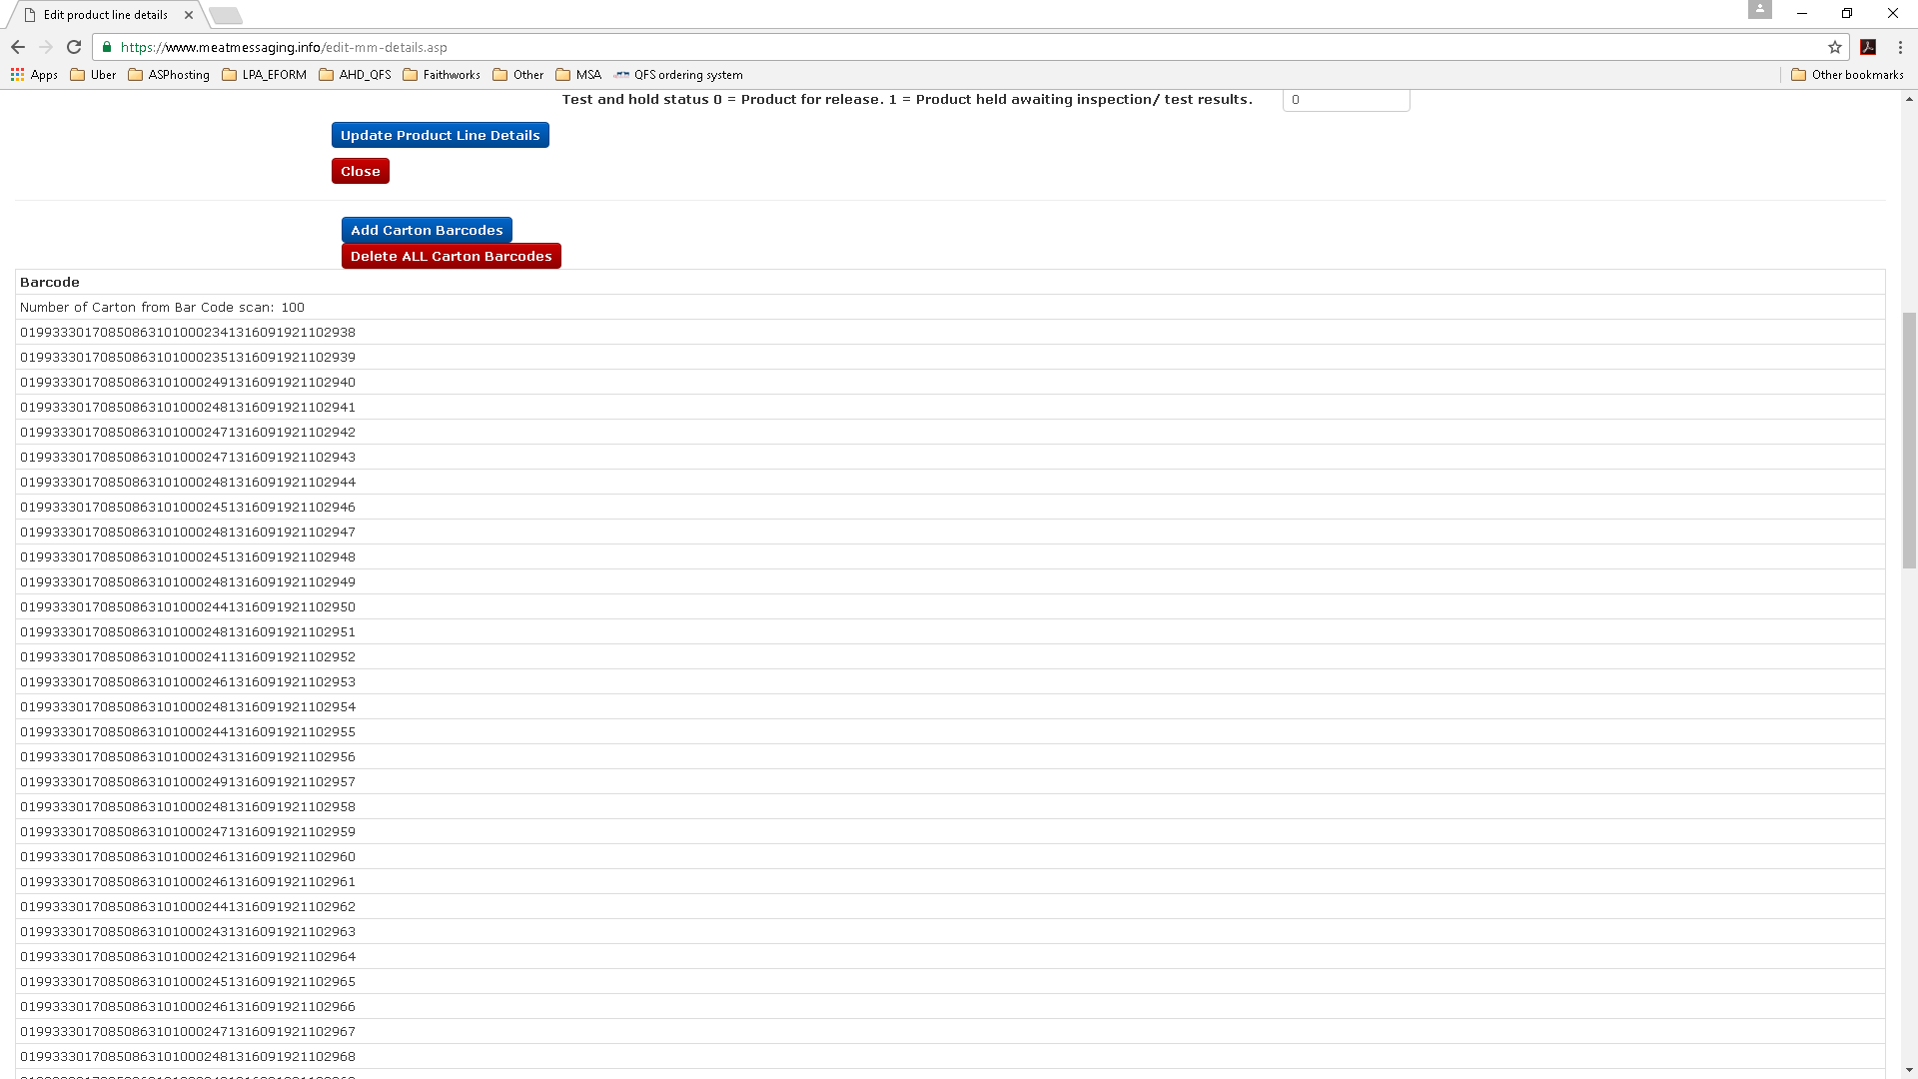
Imported barcodes

Slide 35
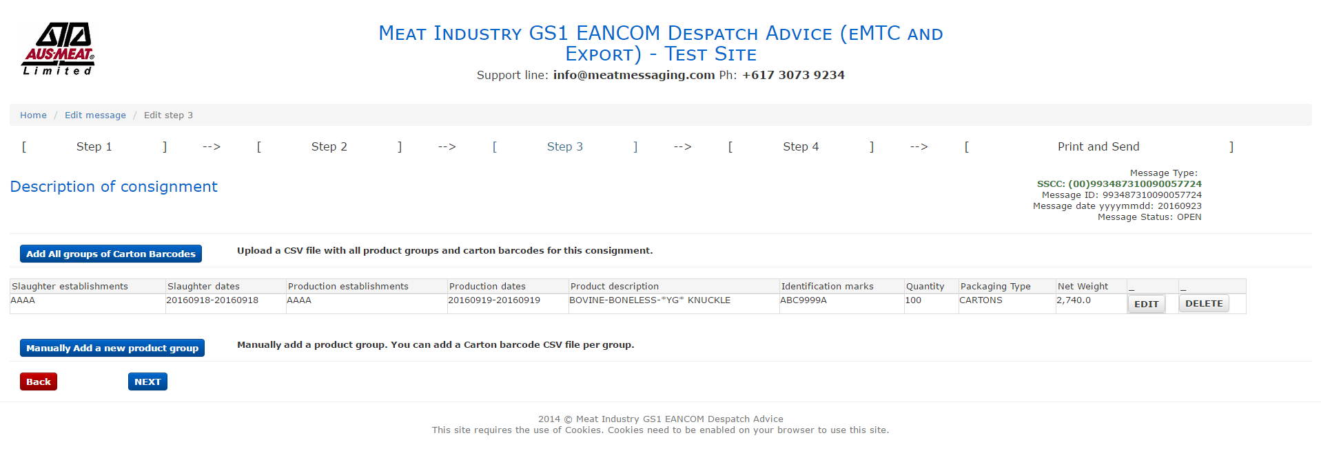

Slide 36
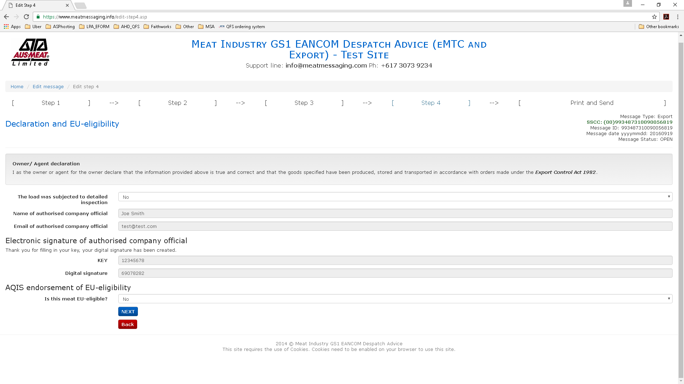

Slide 37
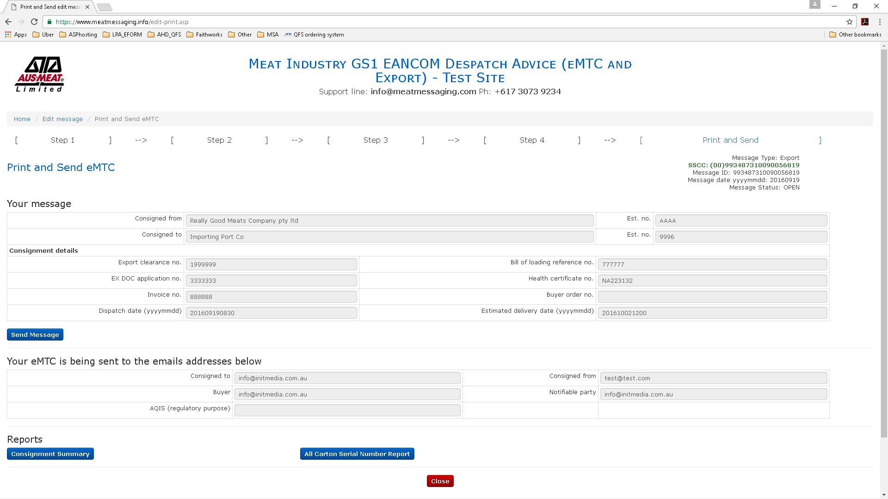
View/print consignment summary

Slide 38
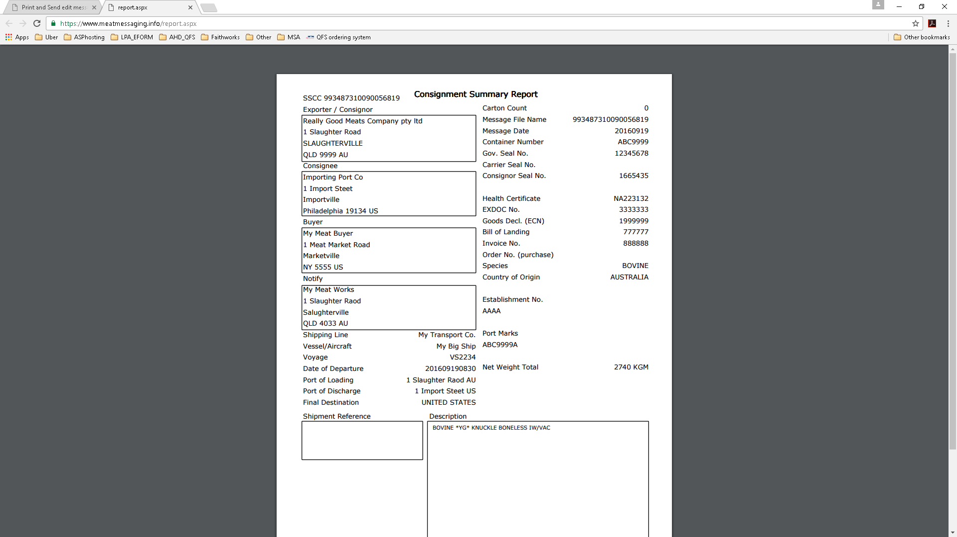
Consignment Summary Report

Slide 39
QA Monitoring
There is a requirement to conduct QA monitoring to ensure that the processes within the establishment are operating correctly.
QA Monitoring can be done using the Meat Messaging portal or through any equivalent system.

Slide 40
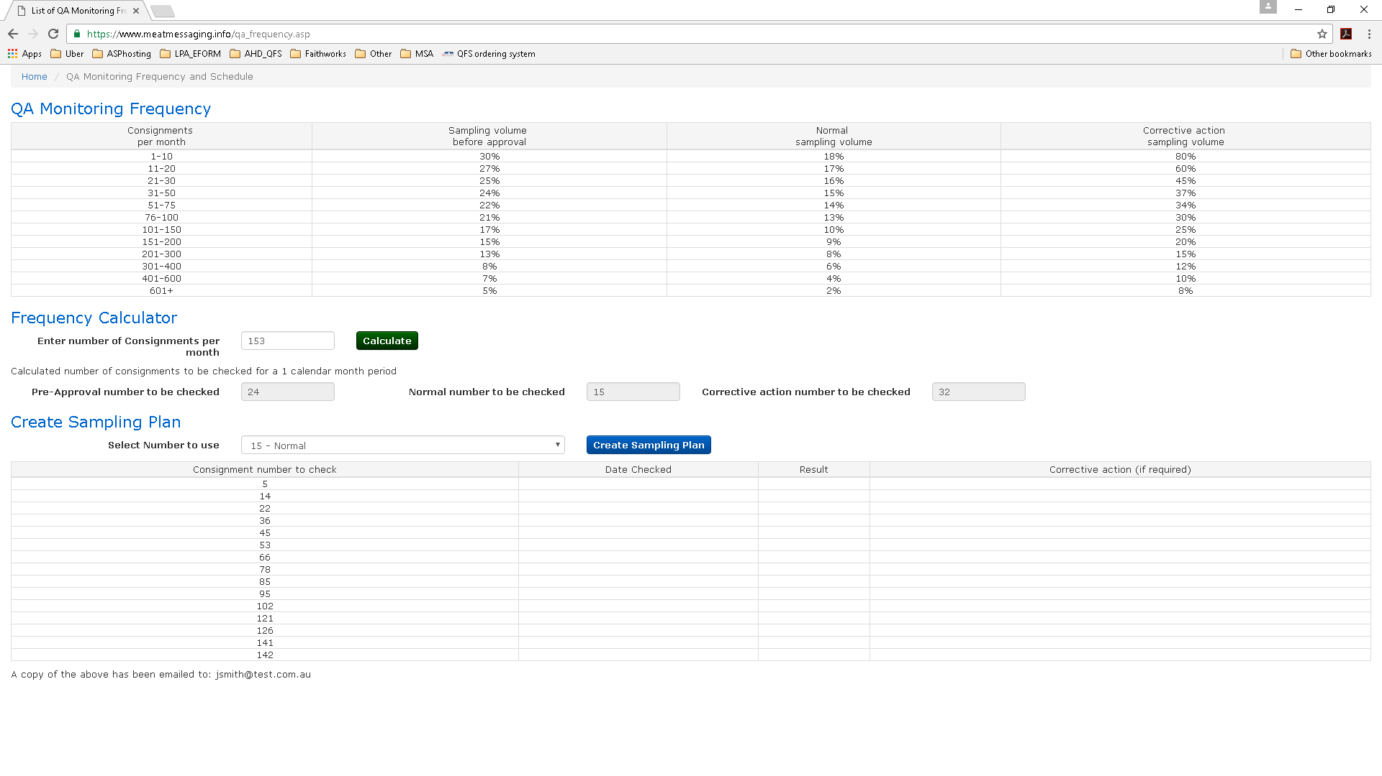

Slide 41
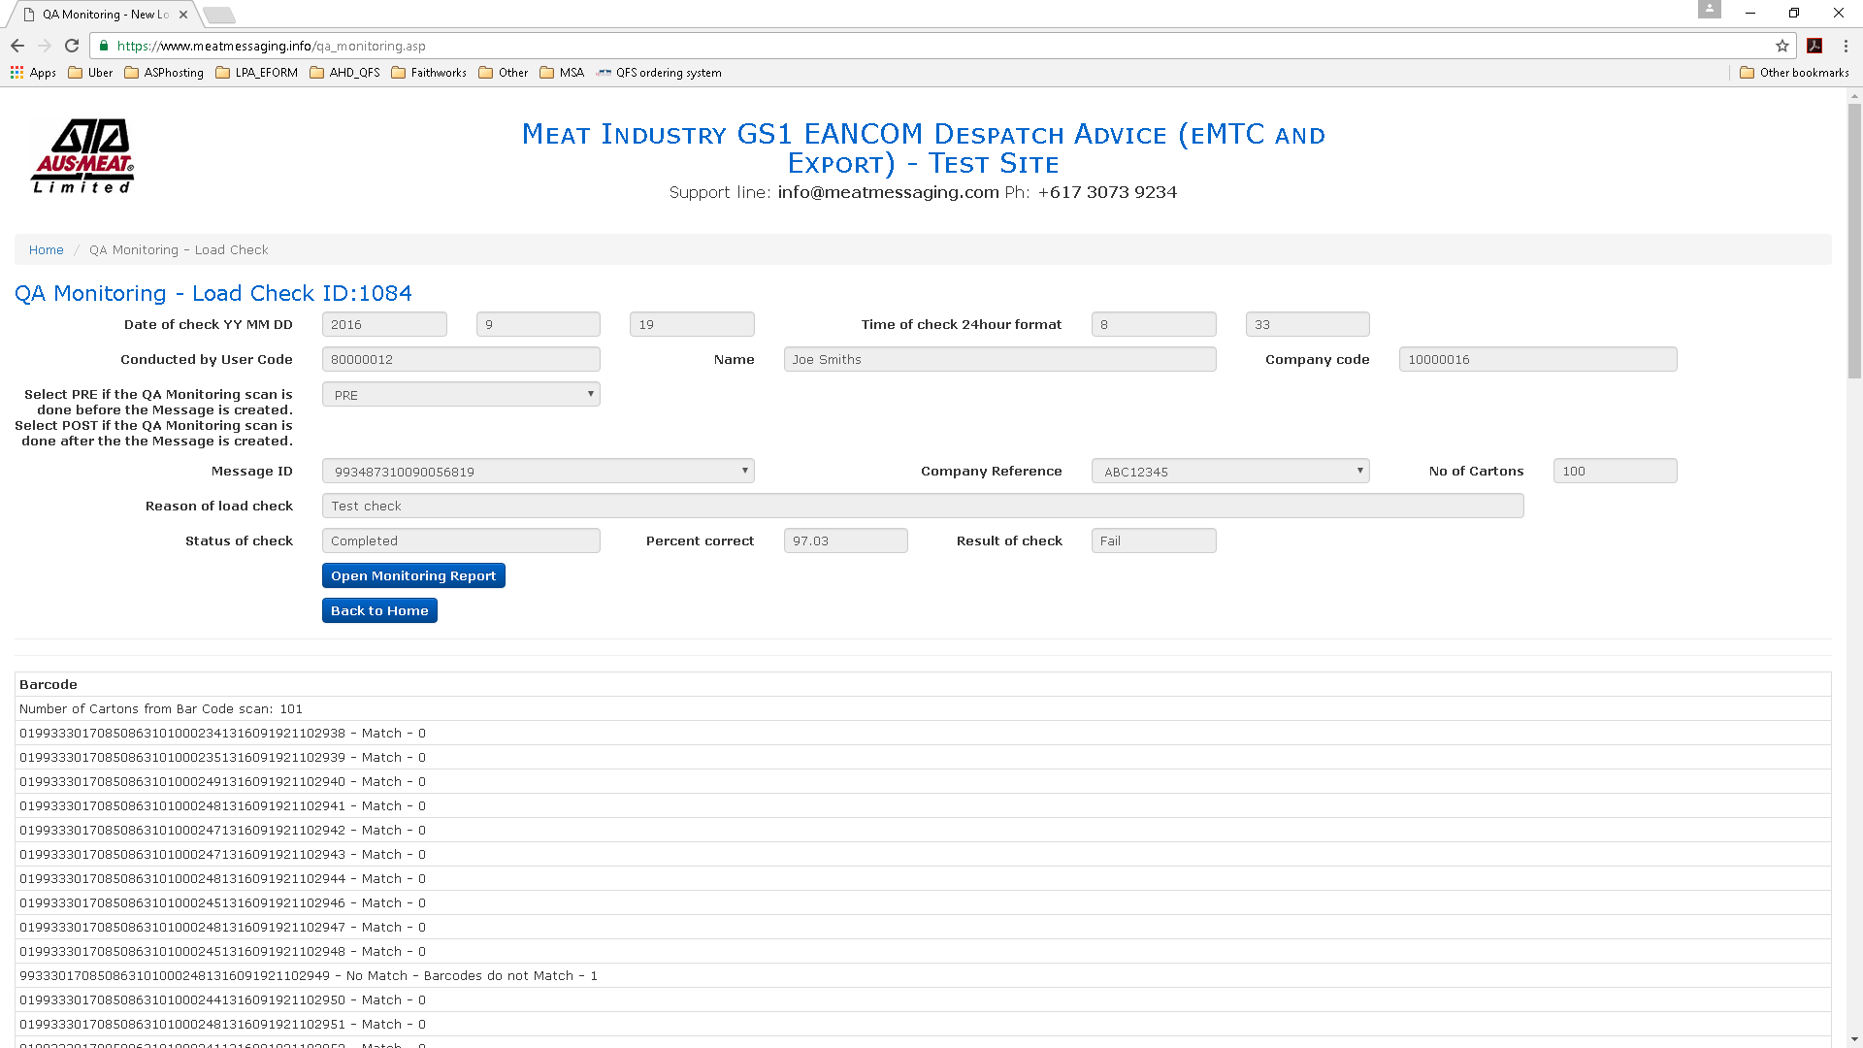

Slide 42
Receiving a consignment
The establishment that receives a consignment can scan the consignment barcodes to match to the message.

Slide 43
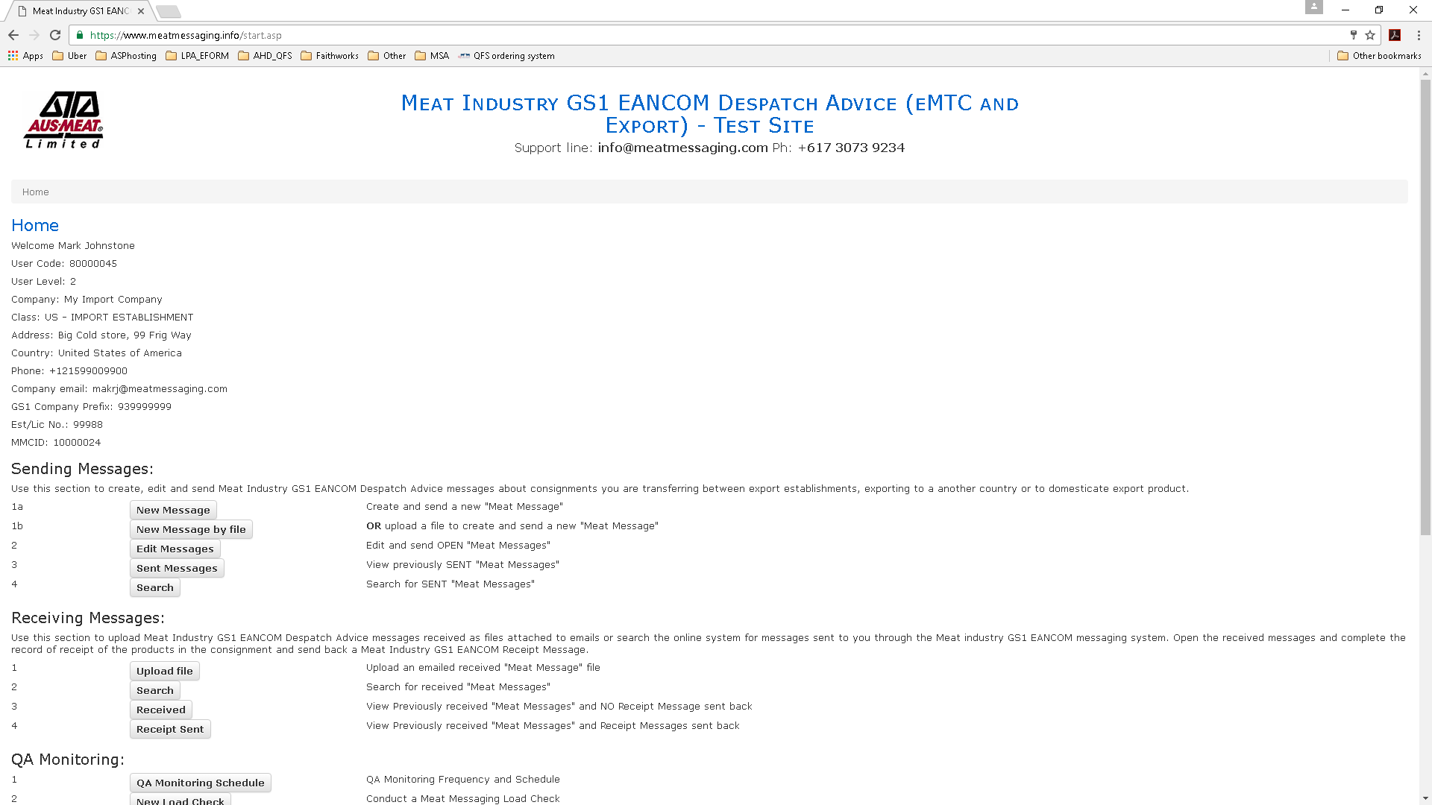
Select to search
for a message

Slide 44
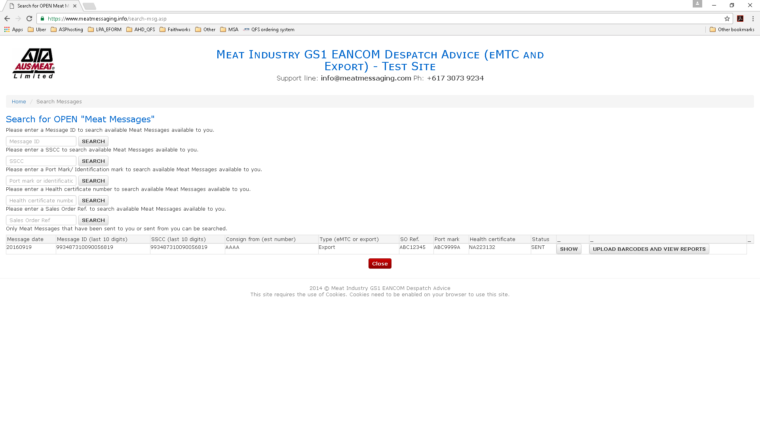
Enter a message id or other search criteria
Then, upload barcodes

Slide 45
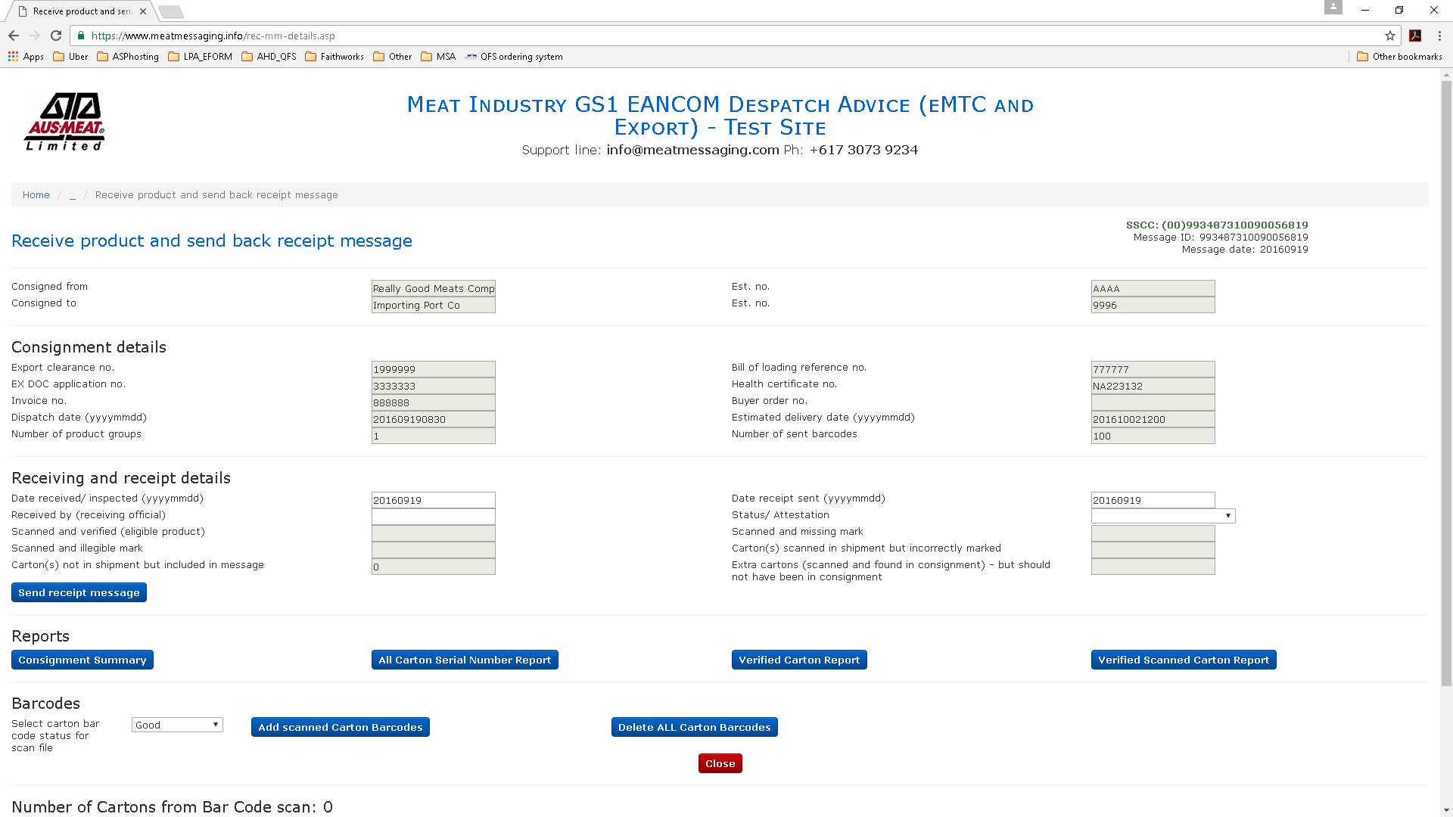
Create a scan file (CSV) by scanning each barcode
Add scanned barcodes

Slide 46
Choose file
Upload and review
Import

Slide 47
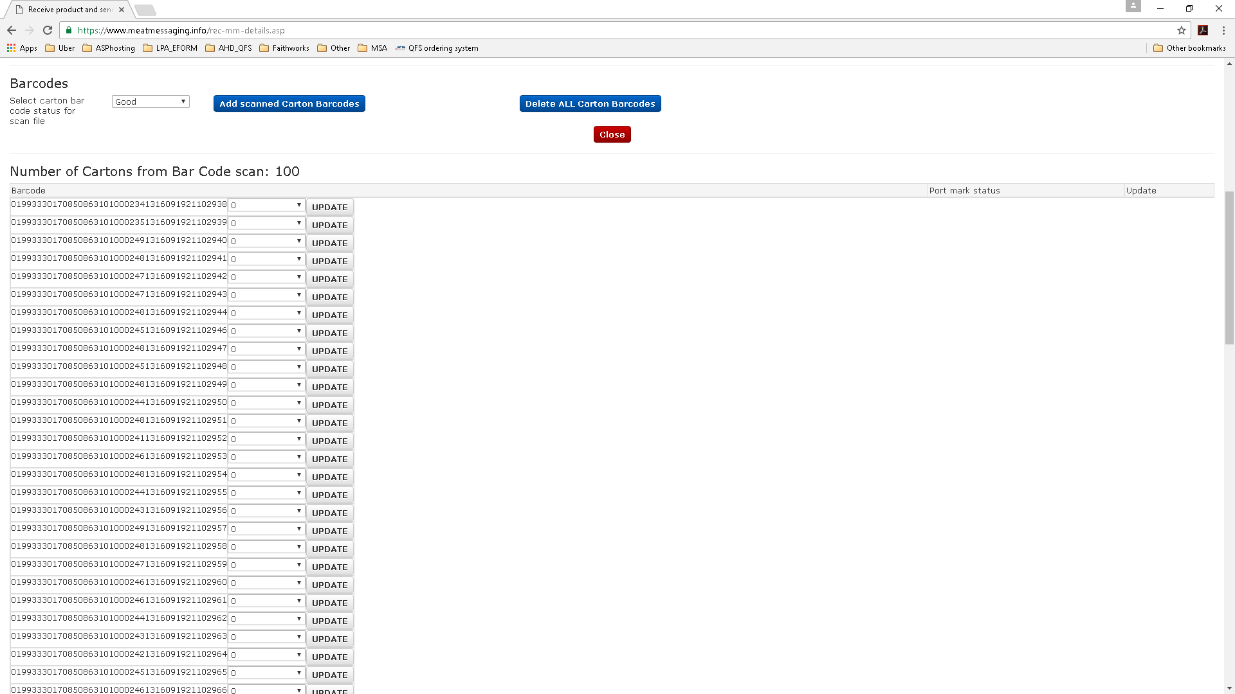
Imported barcodes

Slide 48
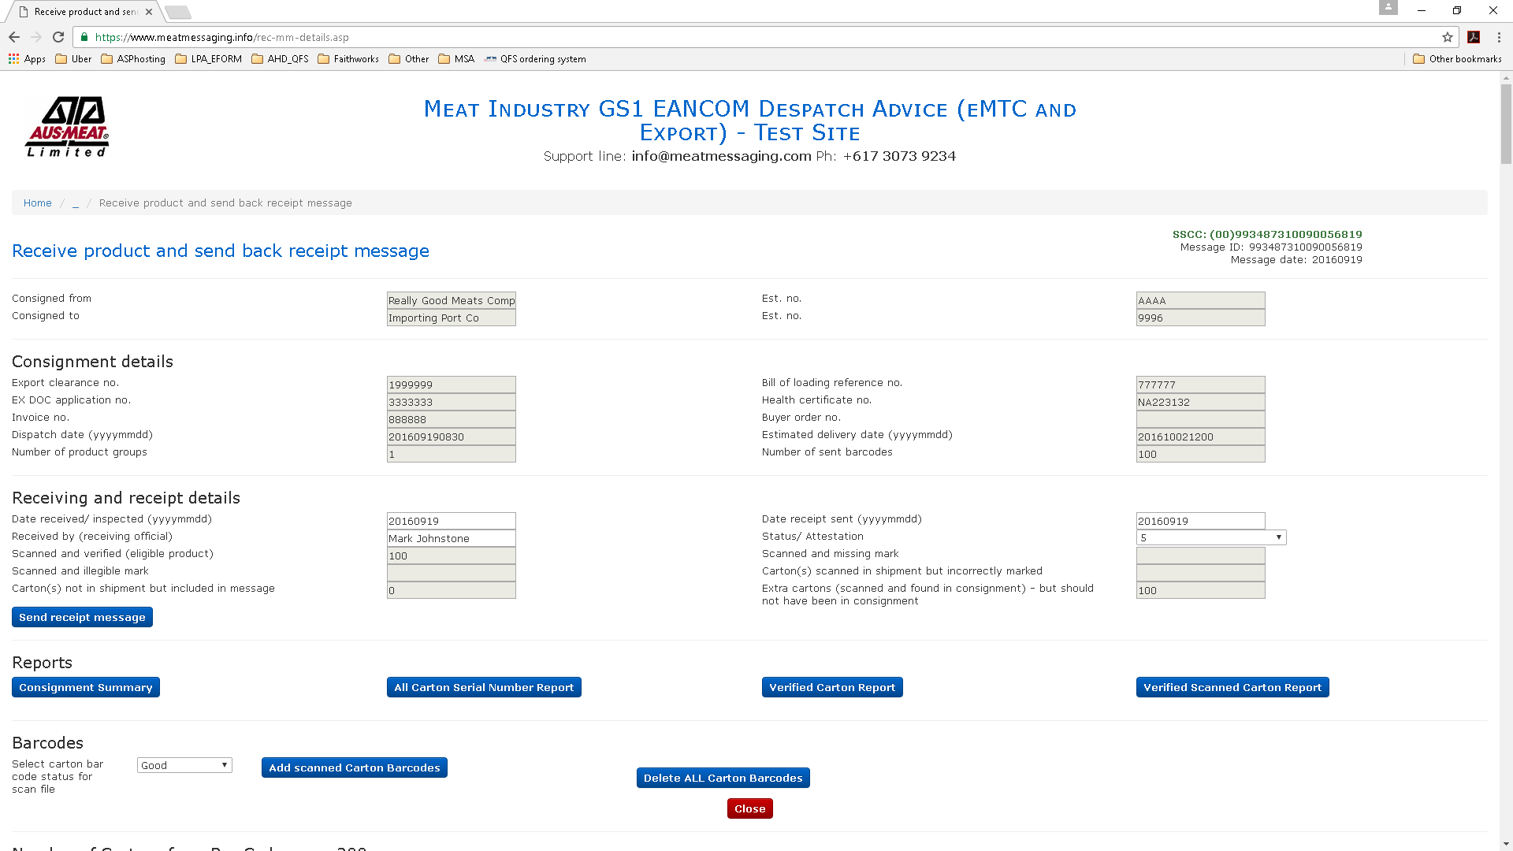
Fill in receiving official
View/print scanned carton report
Send receipt message

Slide 49
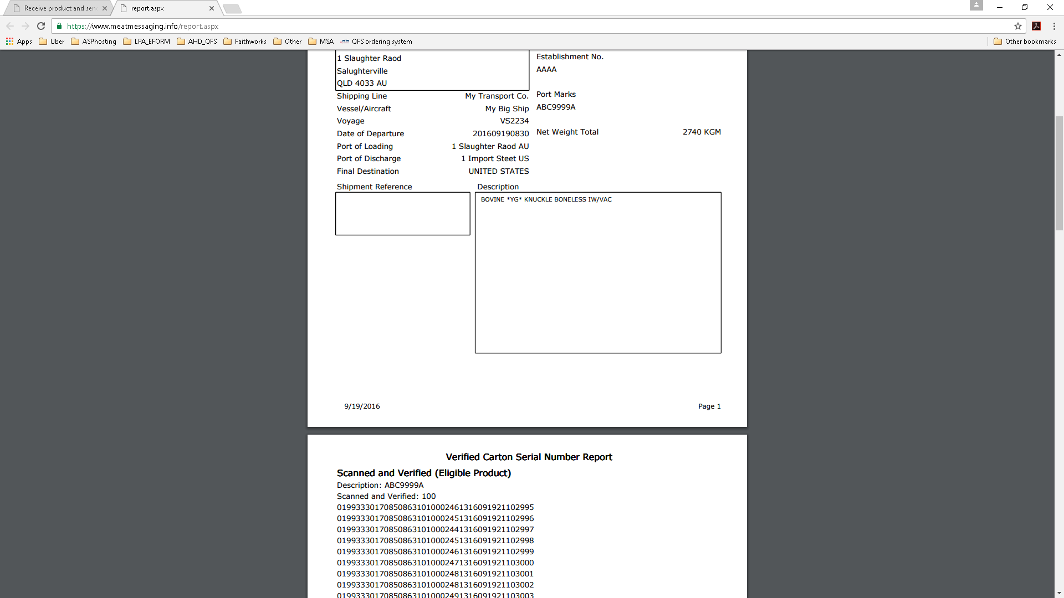
Verified Carton Serial Number Report

Slide 50
MeatMessaging © 2016
For assistance and support please email
info@meatmessaging.com

